Slide 1




CN-MINI PROJECT
SMOKE DETECTION WITH FIRE PREVENTION
USING CISCO PACKET TRACER

Slide 2
Abstract
Fire is the major cause of accidents claiming valuable lives and property. Smoke detectors play an important role in a fire prevention management program. Timely detection of the fireplace is vital for avoiding a serious accident. In this project, a Fire prevention and Smoke detection system is developed. It can sense smoke and the rise in temperature and alert the user by activating the siren and also send commands on the virtual terminal of the android phone through the wifi module. Fire hazards are not uncommon. To avoid injury from fire accidents, smoke detectors are put in high-security places. The hardware used is HomeGateway, Switches, Smoke detectors, Fire sprinklers, Smoke sensor, Wifi Module, and Siren. Software used HomeGateway for mobile applications. These smoke sensors detect smoke because the fire break associated invokes an early alarm. This way, before the fire spreads to different components of the building, people can be evacuated and countermeasures can be done immediately. The detection system operates as a fire detector and smoke detector sensor. In this, we discuss the design and implementation of a smoke detection system using the HomeGateway which operates the entire system

Slide 3
Problem Statement and Objectives
01
Introduction
Home fire detection is a matter of great concern, and thus many efforts are devoted in most developed countries to the design of automatic detection systems. A fire prevention system should reliably and in a timely way notify building occupants about the presence of fire indicators, such as smoke or high temperatures. A fire detector is usually implemented as a smoke sensor due to its early fire detection capability, fast response time, and relatively low cost. Other options for fire detection are based on gas sensors or temperature sensors fire detectors that use a single sensor, generally a smoke sensor, and present high false-siren rates due to temperature changes.

Slide 4
Components Required
02
Smoke detectors
Fire sprinkler
Windows
Doors
Garage door
Siren
Home Gateway
Switch
Smart device

Slide 5
Proposed
Methodology
These smoke & fire detection systems use automatic functions to detect the occurrence of an event that may result in a fire. They receive a sign from a fireplace sensing smoke and mechanically transmit it to the fireplace siren panel. The fire siren panel activates sprinklers and opens all windows and doors.
This project and implement an automatic fire and smoke detection and prevention system that can be produced at a low cost with effective and competitive usage. This System is designed to be more user-friendly and easy to operate at any level. The creation of faster evacuation technologies and safer living conditions at an affordable cost for everyone. This paper discusses the automatic fire detection system, composition, and working principle. The overall structure of the fire detection system and control software in the design. Low-cost fire detection and control system based on smoke detection is proposed. It is a combination of electrical devices working together to detect the presence of fire and alert people. These sirens may be activated from smoke detectors which, when detected, smoke.

Slide 6
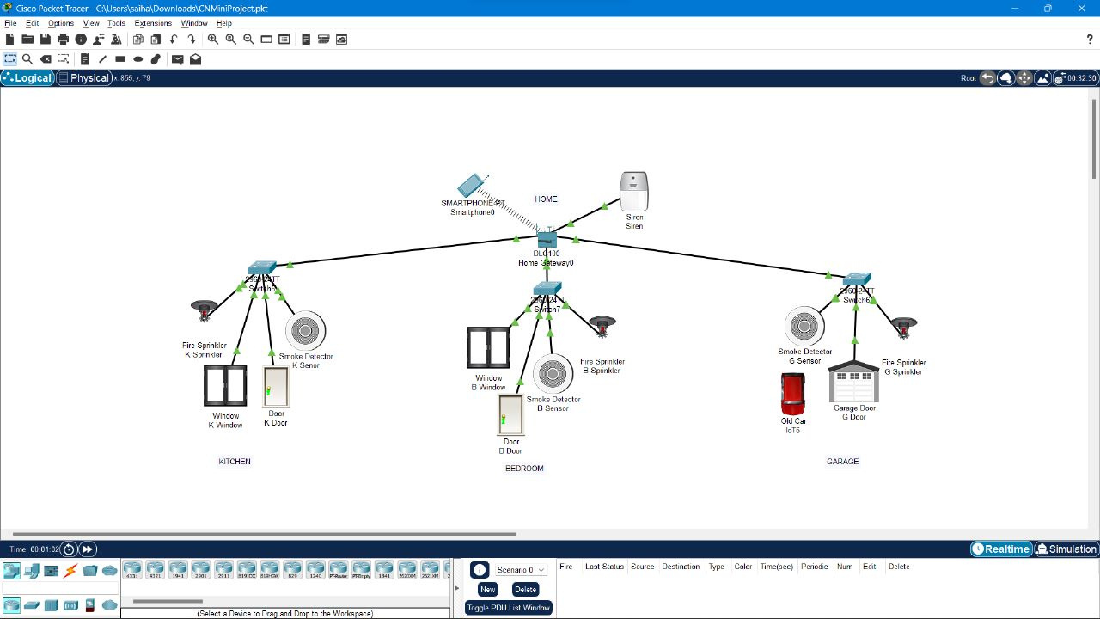
Architecture Diagram

Slide 7


Implementation
Create a house
place the smoke detector in the house
place the fire prevention tools
->fire sprinkler
->open windows and doors
->place siren
place home gateway
place the smart device for access the data
connect/configure all the components with home gateway
->take a switch to connect
->connect switch with home gateway
->configure each component with home gateway
Check them all the components are connected(access smart device)
->username and password = admin
->all sensors are connected

Slide 8
Implementation
8.Write condition for automation of fire prevention
-> when any smoke detector sense the smoke then
->On the Siren
->On the Sprinkler
->Open windows
->Open doors
->when smoke detector sense no smoke the
->Off the Siren
->Off the Sprinkler

Slide 9
Outputs
When no smoke is detected

Slide 10
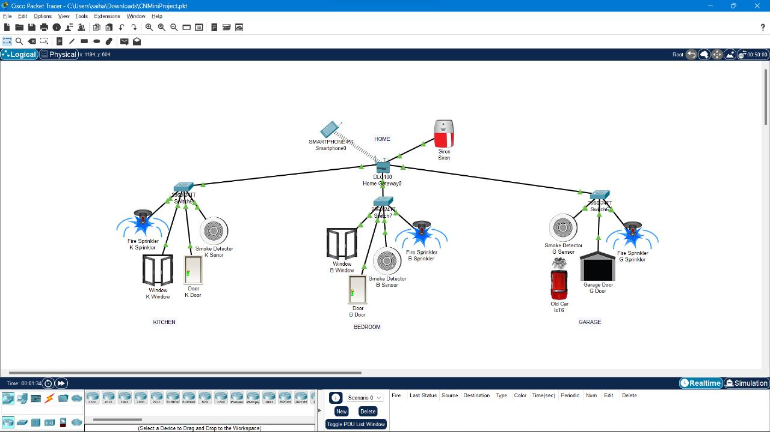
Outputs
When smoke is detected

Slide 11
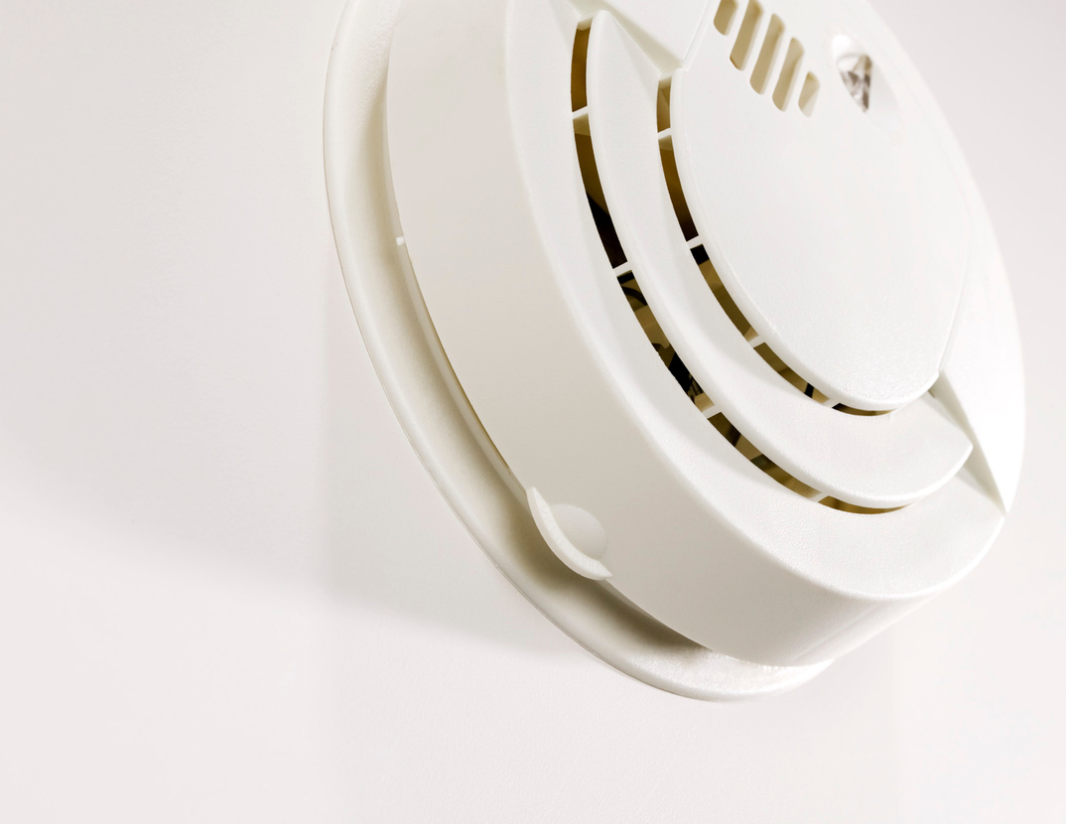

Result
Smoke detectors are great because they save lives. There are smoke detectors formed as noses, to smell for smoke. There
should be a minimum of two or three smoke detectors in your home. You should install a smoke detector on each floor of a
house. Always have a smoke detector and fire prevention system in your home for your safety.

Slide 12
THANK YOU...!!!
1.Sai Harshith Tedla (RA2011003010333)
2.Krishna Chaitanya Thota(RA2011003010340)
3.P Jaswanth(RA2011003010338)
4.Pilli Satya Srinivas(RA2011003010316)

